Slide 1



College Major Employment and Income Outcomes.
Jay Pfister

Slide 2
Introduction
This project is an exploration of college majors and their outcomes with the intent of helping to provide better information to potential students selecting a major.
It approaches this problem from the perspective of pure numbers.
It asks questions like, “Is this major likely to result in a job?” and “Will I make enough money to pay off loans I may have taken out to pay for this education.”

Slide 3
The Data
The data in this presentation was obtained from the American Community Survey conducted in 2012.
The data set is a comprehensive breakdown of college majors and their employability statistics as reported by respondents to the survey.

Slide 4
Questions
Which college majors are most likely to result in gainful employment?
What is the relative income potential of those occupations?
Are there cases where it is likely that a college degree in a given field may not be worth the expense of acquiring it?

Slide 5
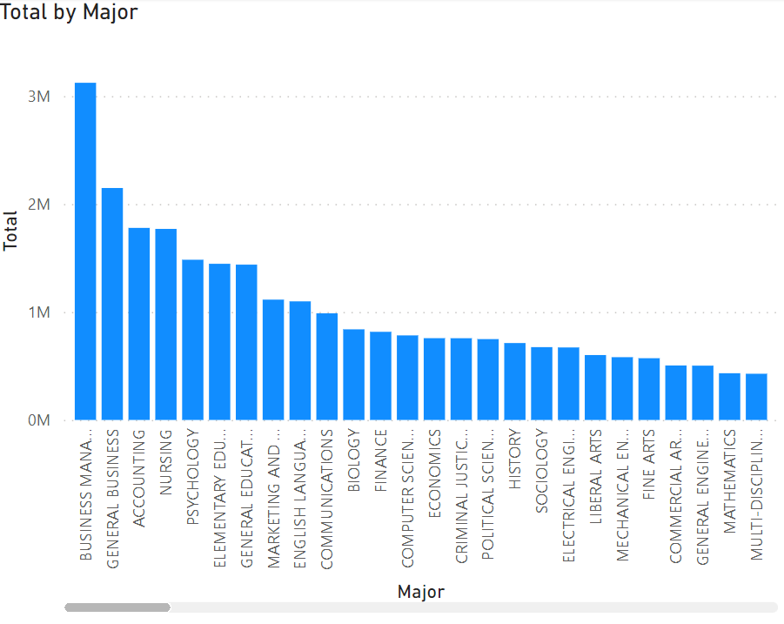
Total Employment by Major

Slide 6
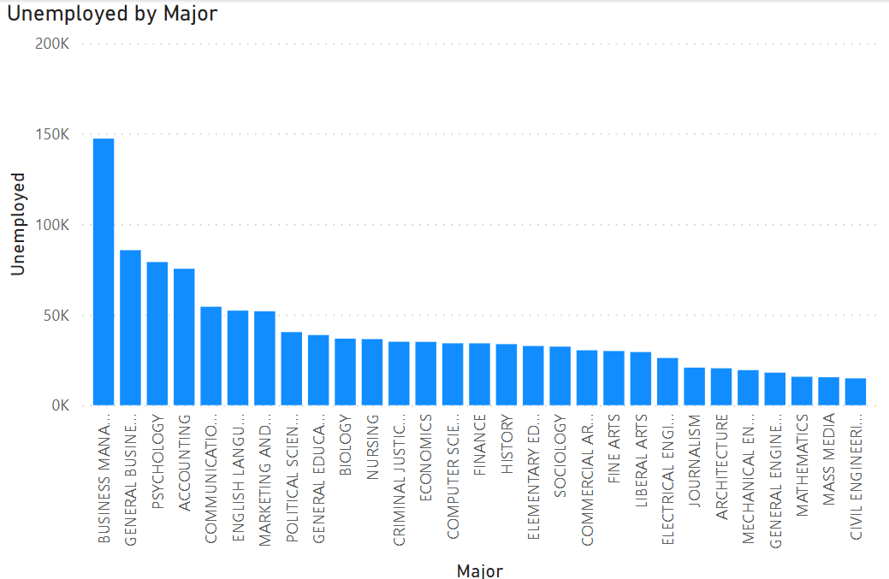
Unemployment by Major

Slide 7
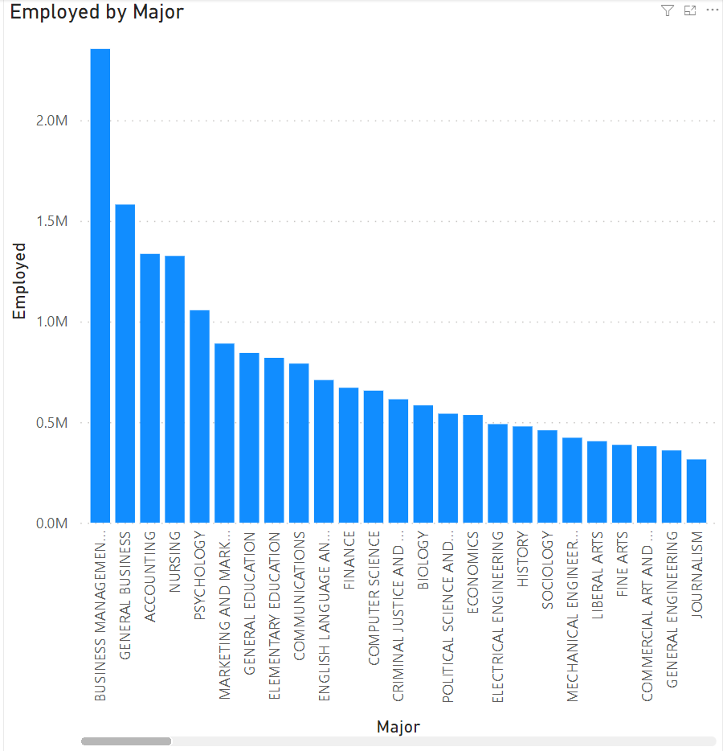
Employment by Major

Slide 8
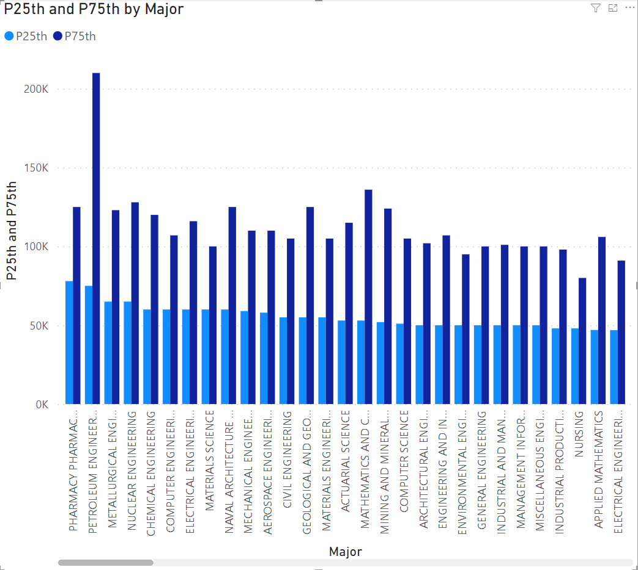
Income Data (25th and 75th percentile)

Slide 9
Answers
There are certain majors which are more likely to result in gainful employment than others.
Of those there are majors that are more likely to result in a higher income level for the graduate.

Slide 10
Conclusion

